Slide 1
Dry season step fitting and power recession fitting
March 21, 2018

Slide 2
Questions for Dave:
How to get started now. Earth Engine group? Relevant lit on summer work?
Workflows, dataset access, statistical models
Summer work: right now have hydroclimatic metric = f(precip, T, land use), but add in soil moisture and ET to the statistical model. Are they a better predictor than precipitation, temperature? How to incorporate into process network diagram? Or will there be some other task that’s more needed this summer?
For Avery:
Toy dynamic model that explores different prescribed/static land use changes (x) in a watershed and use AgroServe knowledge to predict how climate, like P, T, Q, drainage change, and ultimately how the yield is affected. What are appropriate ways to relate climate indeces to yield?

Slide 3
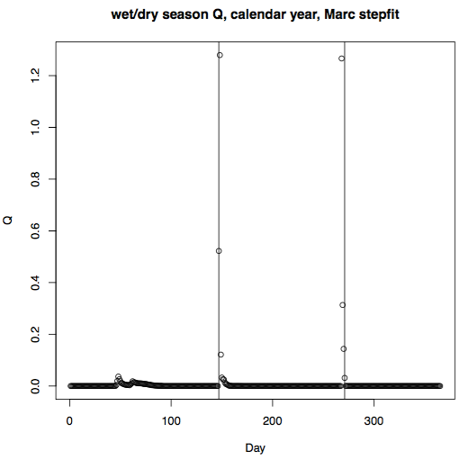
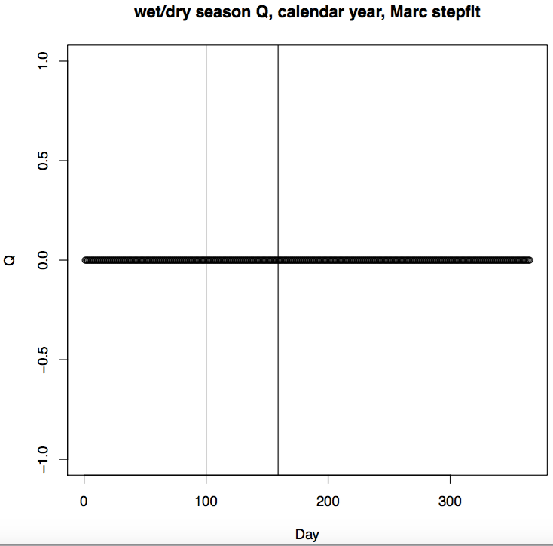
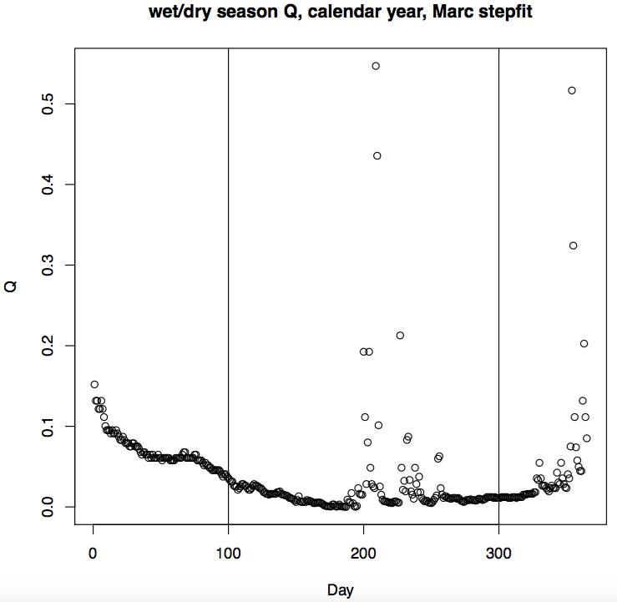
Range of possible dry start and end dates: How did Marc decide?
min nonrainy = 60 days
dry start options: 99 to (300- min nonrainy)
dry end options: (dry start + min nonrainy) to 300
Using different ranges will lead to inclusion of a lot of Decembers (the following wet season)
Some years just don’t seem appropriate for separating a dry vs. wet season. Can we ignore them?
R code: power law recession Marc’s Way.R

Slide 4
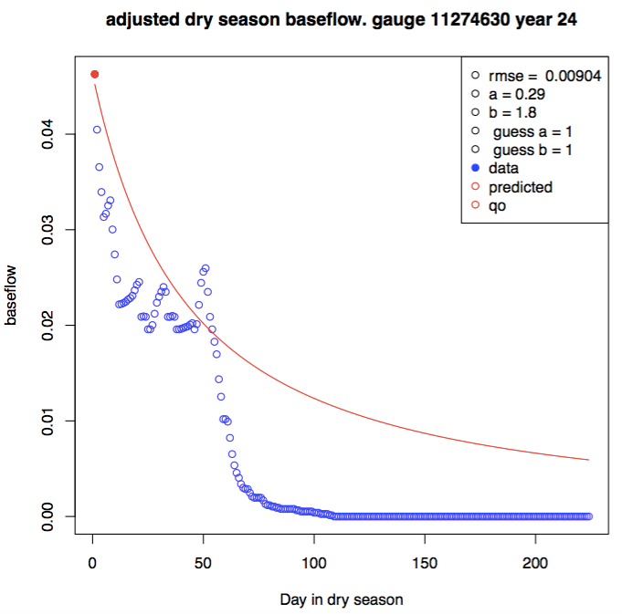
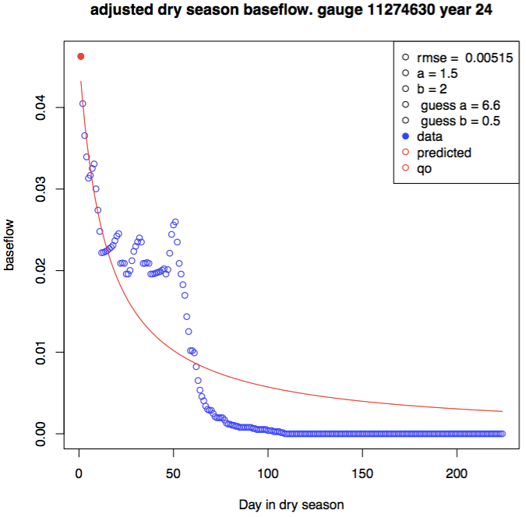
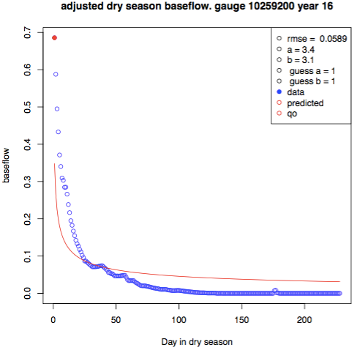
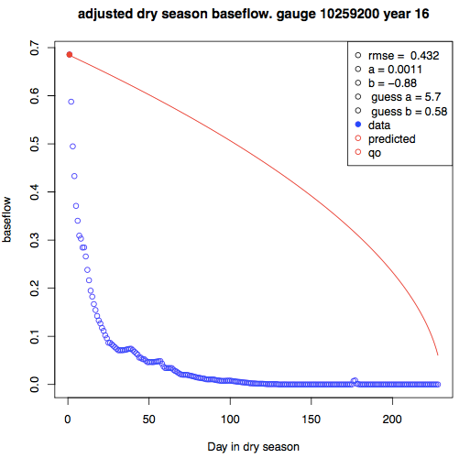
Power law fitting: this was done by SANN, but it requires an initial guess. Compare guessing a = b= 1 to guessing an a, b pair from log fitting. Using log fit doesn’t always give a better answer; sometimes it gets much worse. And when there IS an improvement, it isn’t very much.
For SANN fitting, added large penalty in the objective function whenever a <0 or b <0 so negative a and b parameters are never chosen as the optimizer.
Guesses of a and b are 1
Log fitting to guess a and b for sim annealing
A negative b happened even with the penalty.
Another run with identical code gave a much more reasonable fit.
Take average of many SANN runs and get rid of outliers? Find a better optim method?

Slide 6
TO DO
Draft abstract for CUAHSI on Botter suitability and submit
Things to check
Make table of parameters and relevant files for running Marc’s stuff
For power recession TO DO
Read Dave’s a, b careful paper for more information.
Look at Marc’s code – see if can run them because they would make a good double check/validation of my code
Might need to ignore the “chunks” of constant Q which are probably sensor error.
NSE TO DO
For NSE calcs between data CDF and analytic CDF: take out the first (smallest flow) bin to compare to the dataset that doesn’t have zero flows – to make comparison fair
Note how Marc found NSE – check his code
NOTE how Marc found NSE in his paper: the evaluation metric he uses is NSC for FDC applied to the flow quantiles (350 in all? Or what? – look at Eqn 24). Took log of the flow quantiles before finding NSC to remove effect of very large floods. Used error-duration curves (Pugliese et al, 2013) to assess the repartition of errors across flow quantiles
AgroServe TO DO
Learn Python, Google Earth Engine
https://developers.google.com/earth-engine/tutorials
https://developers.google.com/earth-engine/edu
https://developers.google.com/earth-engine/
Learn crop model from Jake
Ready sociohydrology papers and read Avery’s forest to T to agri prod paper (check Slack) – sensitivity analysis of his work; also adapt his code into R
Overall goal: figure out the land use vs. yield curve by applying crop model to lots of land use caes
in Earth Engine, find mapbiomas dataset. Over the space of Brazil, choose different pixels (around size 1km; aggregate if mapbiomas pixels are smaller). For each pixel, add 2km and 4km rings (called neighborhood 1 and neighborhood 2). For each pixel and ring shaped neighborhood, look at four cases: 0 to 25% soy; 36-50% soy; 51-75% soy; 76-100% soy. Classify each pixel and its neighborhoods in one of these 64 cases.
run the crop model in Google Earth Engine to get an estimate of productivity for all the 64 cases. For me, it will be either natural vegetation or soy. The result of this crop model run is to produce a LC vs. yield graph which will help with the toy model.

Slide 7
Marc’s seasonally dry parameters
Parameter | calculation | file | notes
a, b power law recession | Calibration by simulated annealing | Power law recession Marc’s Way.R | Involves Td calc, baseflow sep. guessed a and b values using log fit before simulated annealing.
Td (for power law recession) | Calculated per individual calendar year | Power law recession Marc’s Way.R and FCN_findDrySeason_stepfit.R | Here, Td is not only step fit of individual year, but is also adjusted to account for the fact that last peak of wet season doesn’t exactly fall on this step fit result. Td here is for Q, not rain. Assumed wet season starts on Jan 1 – i.e. didn’t go beyond calendar year. Should be ok because last peak of wet season unlikely before Jan 1.
Last wet season peak |  | FCN_findLastSeasonPeak.R | This was calculated from start of wet season, not calendar year
Td (overall) | Step fitting of all years’ data | Calculate Dry Season.R | Rainfall and Q season separation using all years simultaneously. Made sure the Td used in Testing Marc Seasonally Dry v2.R corresponds to flow wet/dry delineation, not rainfall wet/dry delineation.

Slide 8
To find last wet season peak, had to first step fit for individual years to find start/stop of dry season. In the end, after trying my own edits on his method, his method works best. Main edit was following his potential start and end dates instead of my own broader range. This helped create dry seasons that didn’t experience increase in streamflow over time.
Part | Marc’s Way FCN_findDrySeason_stepfit.R | My edit on Marc’s way FCN_findDrySeason_stepfit_mean.R
What we optimize in order to determine which pair of start/end dry season dates is best | Minimize: resid<-data$Timeseries-nonrainy*dry.y-(1-nonrainy)*wet.y ssr<-crossprod(resid) importantly, based on tests using practice vectors, crossprod seems to calculate a dot product… Use this in the end, it’s better | Maximize: the difference between mean dry and mean wet streamflow in. This gives the same dry season start and end as Marc’s more complicated method for most years, but sometimes it screws up a LOT. In the end, since Marc’s step fit method does better than the mean method, stick with his method.
Range of possible dry start and end dates: How did Marc decide? This seems kind of arbitrary | min nonrainy = 60 dry start options: 99 to (300- min nonrainy) dry end options: (dry start + min nonrainy) to 300 Use this in the end, it’s better | min nonrainy = 60 (minimum dry season length) dry start options = min nonrainy to (365 – min nonrainy) dry end options =( dry start + min nonrainy) to 365
R code: power law recession Marc’s Way.R

Slide 9
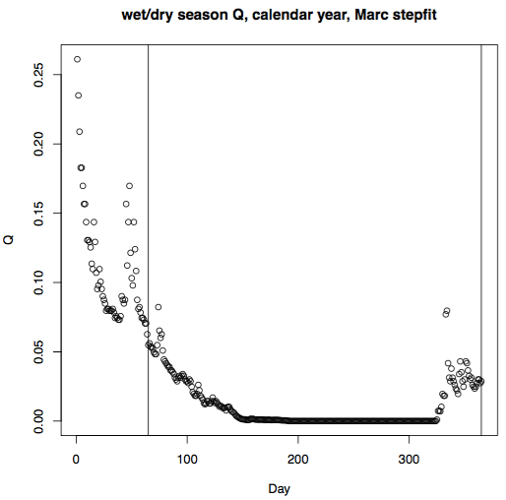
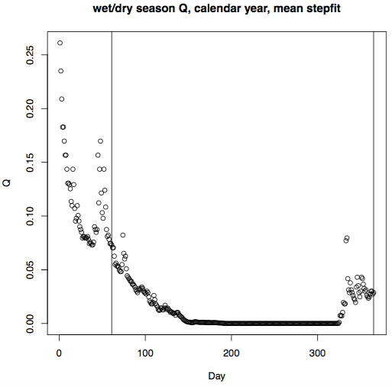
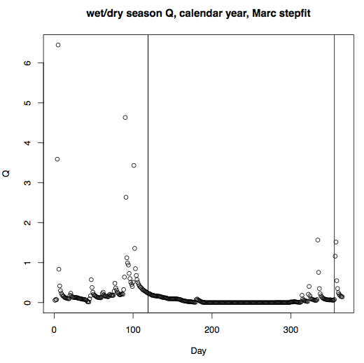
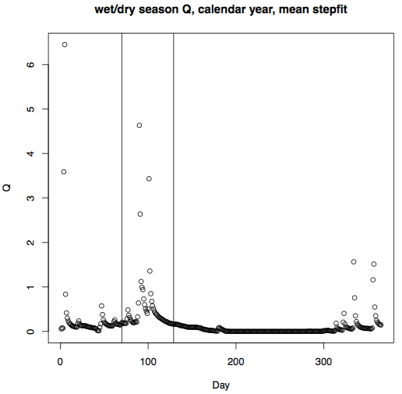
Stepfitting: Marc’s “objective function” for finding the dry season start/stop dates is better
Note that these use my setting for possible dry start and end dates so they might not be accurate
Marc’s method
Maximizing abs(dry_mean – wet_mean)
Usually it’s the same as Marc’s method, but not always. When they are different, Marc’s way is better.
R code: power law recession Marc’s Way.R

Slide 10
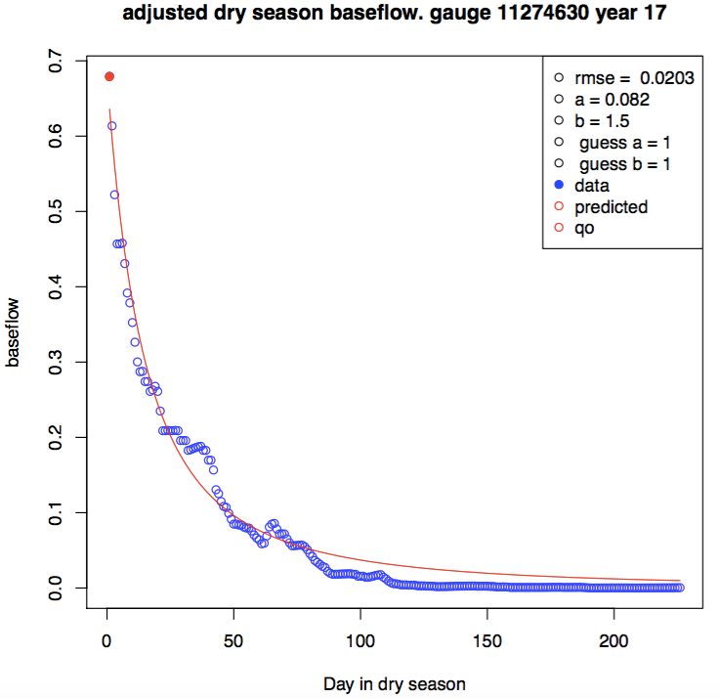
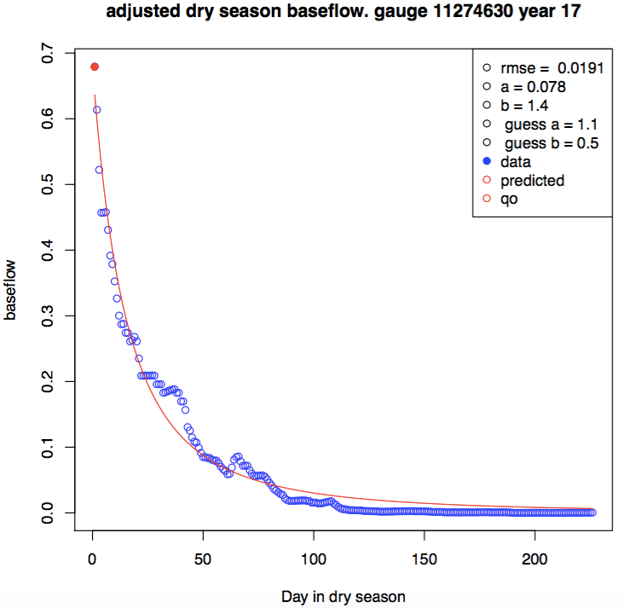
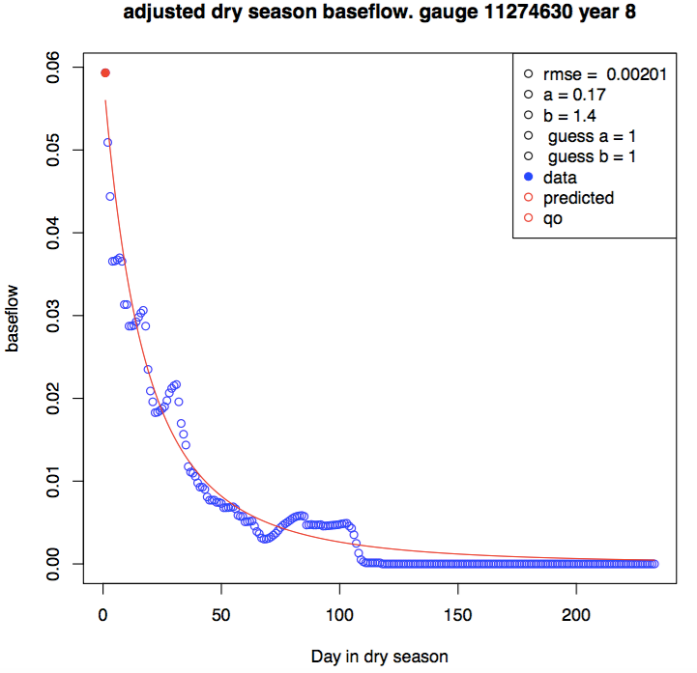
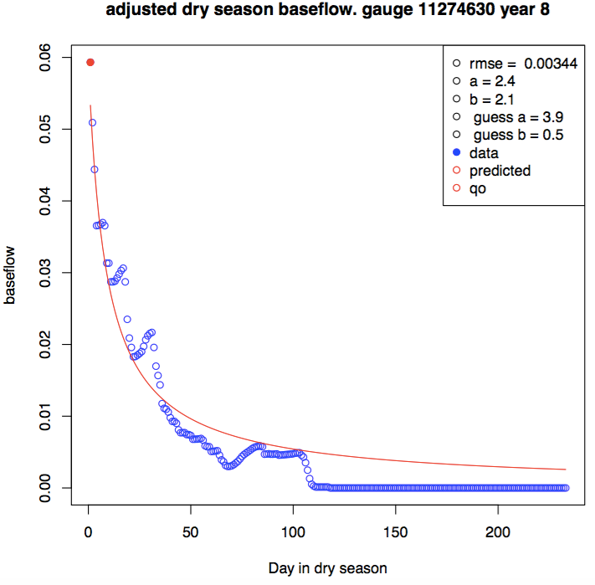
Power law fitting: this was done by SANN, but it requires an initial guess. Compare guessing a = b= 1 to guessing an a, b pair from log fitting. Using log fit doesn’t always give a better answer. And when there IS an improvement, it isn’t very much.
Guesses of a and b are 1
Log fitting to guess a and b for sim annealing

